Slide 1
Stress management

Slide 2
7 tips for managing stress
1. Understand your stress
How do you stress? It can be different for everybody. By understanding what stress looks like for you, you can be better prepared, and reach for your stress management toolbox when needed.
2. Identify your stress sources
What causes you to be stressed? Be it work, family, change or any of the other potential thousand triggers.
3. Learn to recognize stress signals
We all process stress differently so it’s important to be aware of your individual stress symptoms. What are your internal alarm bells? Low tolerance, headaches, stomach pains or a combination from the above Symptoms of stress’.

Slide 3
Stress management
4. Recognize your stress strategies
What is your go-to tactic for calming down? These can be behaviours learned over years and sometimes aren’t the healthy option. For example, some people cope with stress by self-medicating with alcohol or overeating.
5. Implement healthy stress management strategies
It’s good to be mindful of any current unhealthy coping behaviours so you can switch them out for a healthy option. For example, if overeating is your current go to, you could practice meditation instead, or make a decision to phone a friend to chat through your situation. The American Psychological Association suggest that switching out one behaviour at a time is most effective in creating positive change.

Slide 4
Stress management
6. Make self-care a priority
When we make time for ourselves, we put our well-being before others. This can feel selfish to start, but it is like the airplane analogy—we must put our own oxygen mask on before we can assist others. The simplest things that promote well-being, such as enough sleep, food, downtime, and exercise are often the ones overlooked.
Self-care is group-care.
7. Ask for support when needed
If you’re feeling overwhelmed, reach out to a friend or family member you can talk to. Speaking with a healthcare professional can also reduce stress, and help us learn healthier coping strategies.

Slide 5
Workplace/organizational stress
Stress Management In The Workplace
Whether it be extended hours, near impossible deadlines, demanding colleagues or unappreciative bosses, workplace stress is something many people are familiar with.

Slide 6
Workplace/organizational stress
According to the World Health Organization’s definition, occupational or work-related psychosocial stress “is the response people may have when presented with work demands and pressures that are not matched to their knowledge and abilities and which challenge their ability to cope.” (Leka, Griffiths, & Cox, 2003)

Slide 7
Workplace/organizational stress
But the effects of workplace stress aren’t simply isolated to the workplace; they spill over into our personal relationships, our home lives, and our overall productivity.
Duke University found that workplace stress was responsible for over 70% of workplace accidents, 50% of absenteeism (“Stress Facts in the Workplace,” 2018).

Slide 8
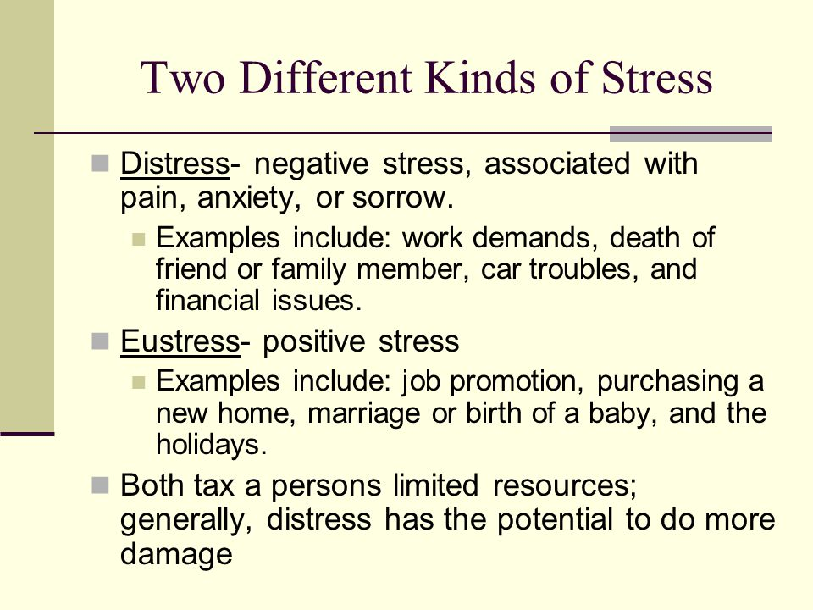

Slide 9
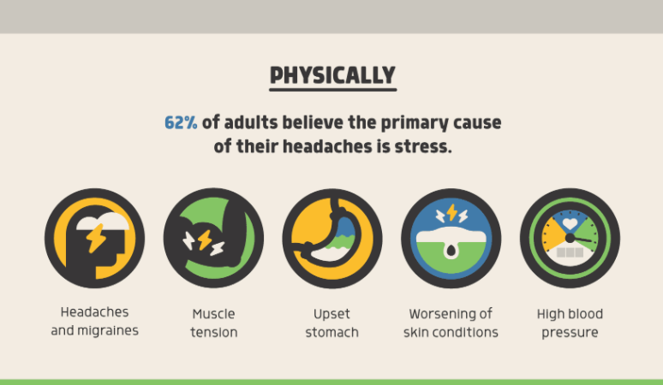
Practical implementation to reduce stress

Slide 10
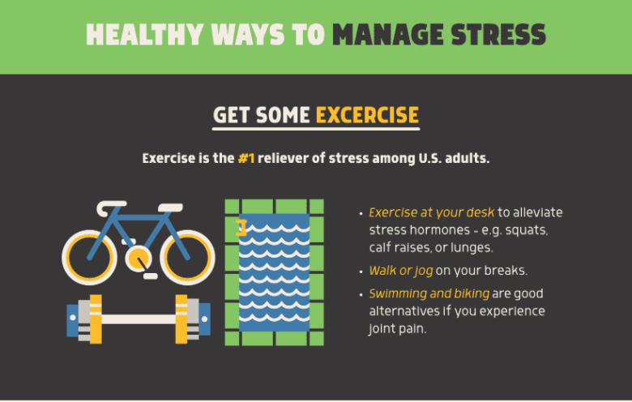

Slide 11
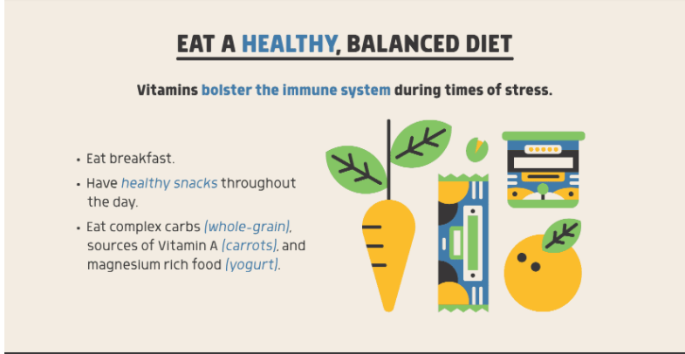

Slide 12
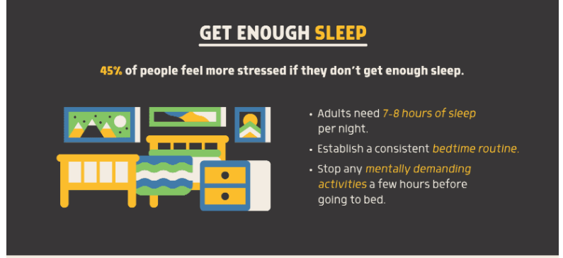

Slide 13
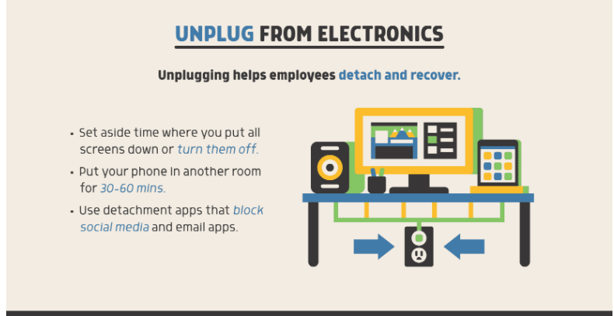

Slide 14
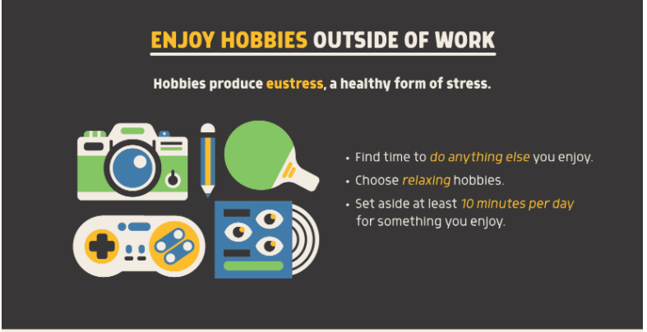

Slide 15
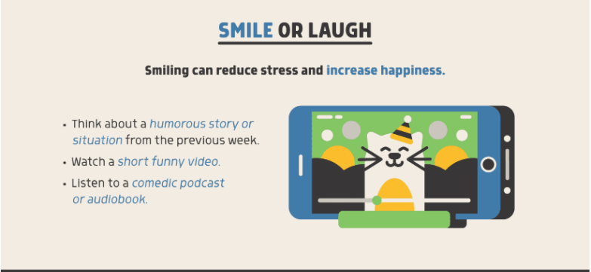

Slide 16
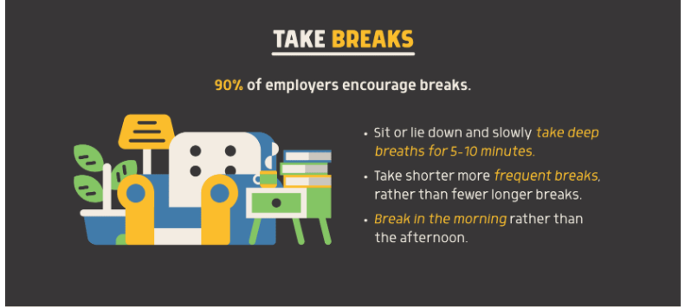

Slide 17
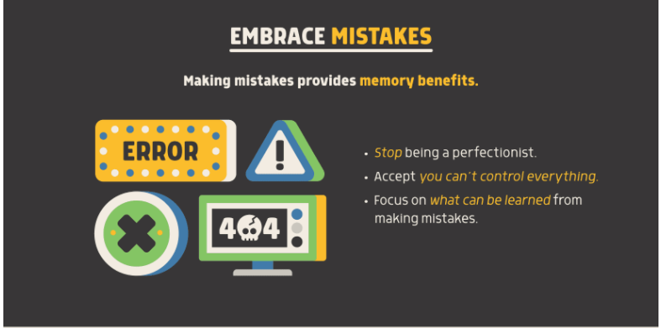

Slide 18
